Slide 1
Encryption and Security in GCP Data Process Engineering
Exploring key techniques and best practices
Speaker : Nikhil Shah
Notes:
--- This presentation will explore the critical aspects of encryption and security within the realm of Google Cloud Platform (GCP) data process engineering. We will cover various encryption techniques, security best practices, compliance measures, and real-world applications.

Slide 2
Agenda Items
Introduction to GCP Data Process Engineering
Encryption Techniques in GCP
Security Best Practices in GCP
Data Protection and Compliance
Case Studies and Real-World Applications
Notes:
Our journey begins with an overview of GCP data process engineering, emphasizing the importance of security. We will then delve into the different encryption techniques available in GCP, followed by best practices to secure data. Lastly, we will examine compliance requirements and real-world applications of these security measures.

Slide 3
Introduction to GCP Data Process Engineering
Notes:
Understanding GCP data process engineering is essential for leveraging the platform effectively. This section will introduce the core principles and significance of security in data processing.

Slide 4

Overview of Google Cloud Platform (GCP)
Cloud Computing Services
GCP provides a range of cloud computing services that cater to diverse organizational needs, enhancing operational efficiency.
Data Storage Solutions
GCP offers advanced data storage solutions that enable organizations to store and retrieve data securely and efficiently.
Data Processing and Analysis
Organizations can leverage GCP's tools for data processing and analysis to make informed decisions based on insights from their data.
Notes:
Google Cloud Platform (GCP) is a suite of cloud computing services that runs on the same infrastructure that Google uses internally. It offers various tools and services for data storage, processing, and analysis, allowing organizations to manage their data efficiently.

Slide 5

Key Components of GCP Data Process Engineering
Google BigQuery
Google BigQuery is a powerful analytics tool that allows for the analysis of large datasets in real-time, enabling fast decision-making.
Cloud Dataflow
Cloud Dataflow is a fully managed service for stream and batch data processing, facilitating the creation of data pipelines that are efficient and scalable.
Cloud Storage
Cloud Storage provides a highly scalable and durable storage solution, essential for storing and accessing large volumes of data in the cloud.
Notes:
GCP data process engineering encompasses several key components, including Google BigQuery for data analytics, Cloud Dataflow for data processing, and Cloud Storage for scalable data storage. Each component plays a vital role in building robust data workflows.

Slide 6

Importance of Security in Data Processing
Data Integrity
Maintaining data integrity is essential to ensure that information remains accurate and trustworthy throughout processing.
Confidentiality Protection
Confidentiality measures protect sensitive information from unauthorized access and potential data breaches.
Availability of Data
Ensuring data availability allows organizations to access critical information when needed, minimizing operational disruptions.
Notes:
Security is paramount in data processing, particularly in cloud environments. Ensuring data integrity, confidentiality, and availability protects against unauthorized access and data breaches, which can have severe consequences for organizations.

Slide 7
Encryption Techniques in GCP
Notes:
Encryption is a fundamental aspect of securing data in GCP. This section will explore various encryption techniques that are crucial for protecting sensitive data both at rest and in transit.

Slide 8

Encryption at Rest
Data Protection
Encryption at rest protects stored data from unauthorized access, ensuring data integrity and confidentiality.
Automatic Encryption
GCP automatically encrypts data prior to being written to disk, using advanced encryption standards for security.
User-Controlled Encryption Keys
Users have the option to manage their own encryption keys, providing greater control over data security.
Notes:
Encryption at rest ensures that data stored in GCP services is protected against unauthorized access. GCP automatically encrypts data before it is written to disk, using advanced encryption standards. Users can also manage their own encryption keys for added control.

Slide 9

Encryption in Transit
Data Protection During Transmission
Encryption in transit safeguards data as it moves between users and services, preventing unauthorized access.
Secure Communication Protocols
GCP utilizes secure protocols like HTTPS and TLS, providing confidentiality and preventing data interception.
Confidentiality Assurance
The use of encryption ensures that sensitive information remains confidential during its journey across networks.
Notes:
Encryption in transit protects data as it travels between users and GCP services. GCP employs secure protocols such as HTTPS and TLS, ensuring that data remains confidential and secure from interception during transmission.

Slide 10

Client-Side Encryption
Data Control
Client-side encryption allows users to maintain complete control over their encryption keys, enhancing data security.
Secure Data Transfer
Data is encrypted before sending to GCP, making it unreadable during transfer and ensuring privacy.
Authorized Access Only
Only authorized parties can decrypt and access the data, ensuring confidentiality and integrity.
Notes:
Client-side encryption involves encrypting data before it is sent to GCP. This gives users complete control over their data's encryption keys and ensures that data is unreadable during transfer and storage unless decrypted by authorized parties.

Slide 11
Security Best Practices in GCP
Notes:
Implementing security best practices is essential for safeguarding data in GCP. This section will outline key practices that organizations should adopt to enhance their security posture.

Slide 12

Identity and Access Management (IAM)
Role Definition
Defining roles is essential for effective IAM, ensuring users have the correct access based on their responsibilities.
Permissions Management
Managing permissions allows organizations to control access to sensitive data and services, mitigating security risks.
Security Enhancement
Effective IAM practices enhance security by preventing unauthorized access to critical resources and data.
Notes:
IAM is crucial in managing access to GCP resources. By defining roles and permissions, organizations can ensure that only authorized users have access to sensitive data and services, thereby minimizing the risk of unauthorized access.

Slide 13
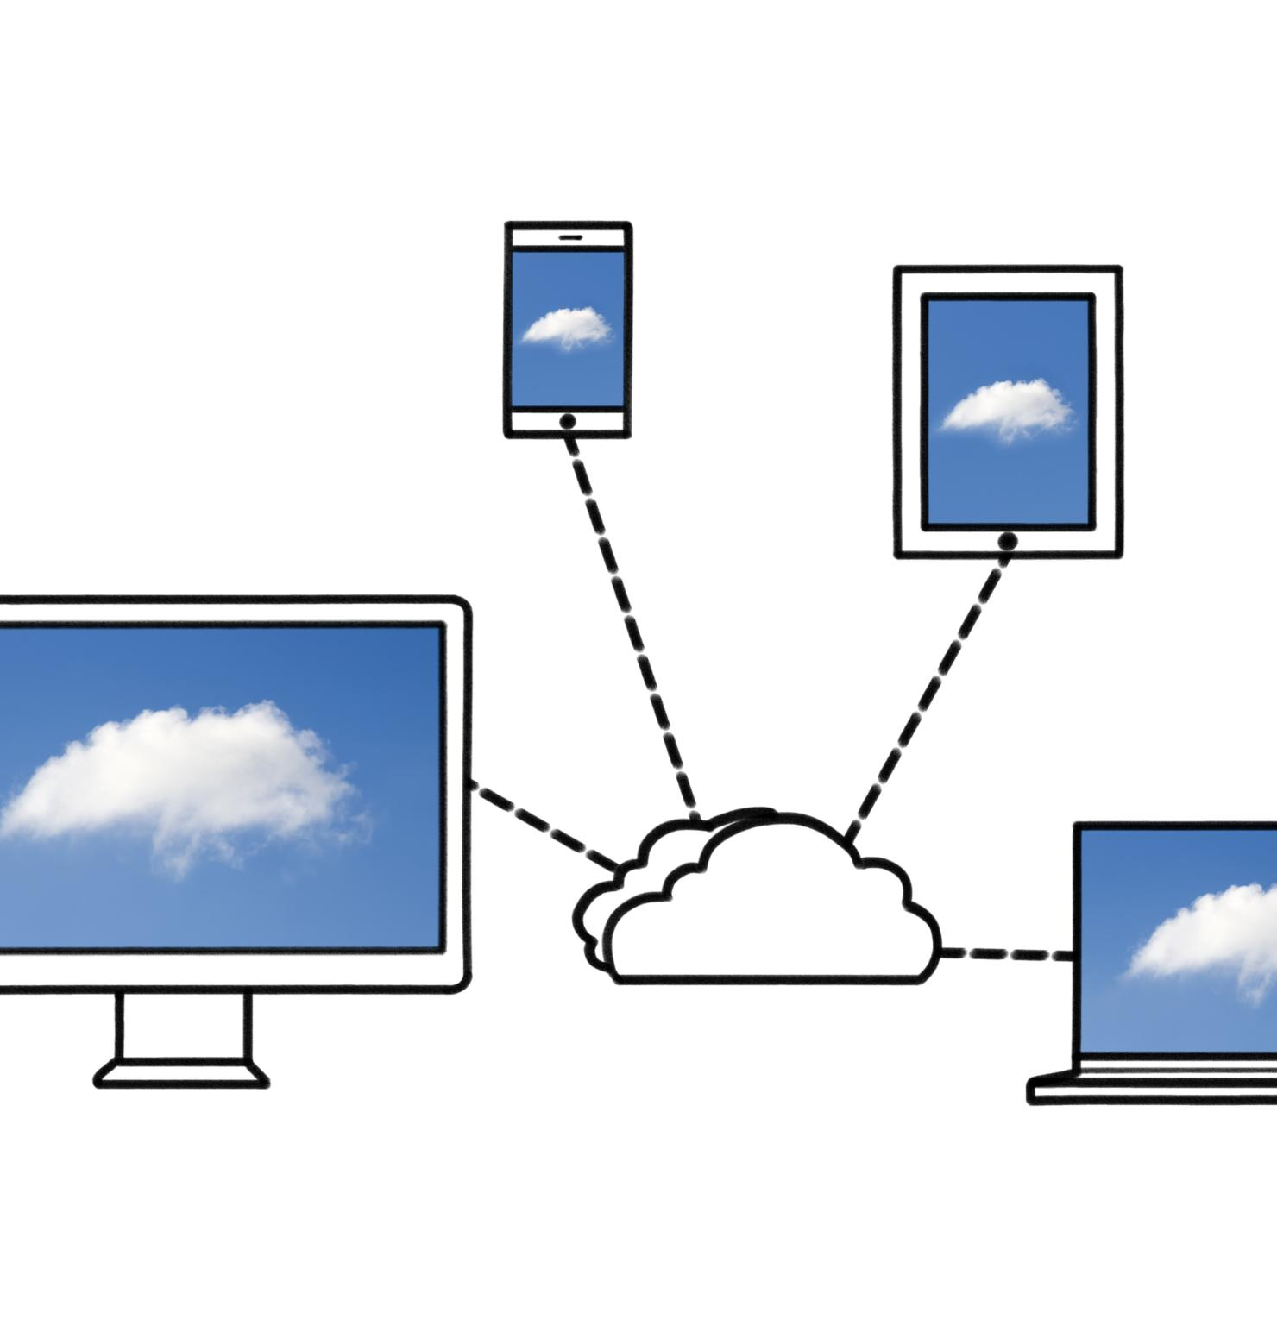
Setting up VPC and Firewall Rules
Understanding VPC
A Virtual Private Cloud (VPC) provides a secure and isolated environment for deploying resources in Google Cloud Platform (GCP).
Importance of Firewall Rules
Properly configured firewall rules are crucial for controlling traffic to and from resources, enhancing security against unauthorized access.
Traffic Control
Effective firewall rules help regulate incoming and outgoing traffic, ensuring that only legitimate communication is allowed within the VPC.
Notes:
A Virtual Private Cloud (VPC) allows organizations to create isolated networks within GCP. Setting up appropriate firewall rules is essential to control traffic and protect resources from potential threats, enhancing overall security.

Slide 14

Monitoring and Logging for Security
Importance of Continuous Monitoring
Continuous monitoring is crucial for identifying security incidents and ensuring a quick response to potential threats.
Cloud Audit Logs
Cloud Audit Logs are essential for tracking user activity and system changes, aiding in compliance and security investigations.
Security Command Center
The Security Command Center helps organizations detect anomalies and assess security risks within their cloud environment.
Notes:
Continuous monitoring and logging are vital for identifying and responding to security incidents. GCP provides tools such as Cloud Audit Logs and Security Command Center to help organizations detect anomalies and maintain compliance.

Slide 15
Data Protection and Compliance
Notes:
Data protection and compliance are critical for organizations operating in regulated industries. This section will discuss regulatory requirements, data loss prevention, and tools available in GCP to maintain compliance.

Slide 16

Regulatory Requirements and Standards
Key Regulatory Requirements
Organizations must adhere to various regulatory requirements including GDPR, HIPAA, and PCI DSS to protect sensitive data.
Importance of Compliance
Compliance with these regulations is crucial for organizations to avoid legal penalties and protect consumer data.
GCP Features
Google Cloud Platform (GCP) provides features that assist organizations in meeting regulatory standards effortlessly.
Notes:
Organizations must comply with various regulatory requirements, such as GDPR, HIPAA, and PCI DSS. GCP offers features that help meet these standards, ensuring that data is handled in accordance with legal obligations.

Slide 17

Data Loss Prevention (DLP)
Identifying Sensitive Data
DLP tools assist organizations in identifying and classifying sensitive data, which is crucial for effective protection.
Implementing DLP Policies
By implementing DLP policies, organizations can proactively prevent data breaches and protect sensitive information.
Regulatory Compliance
DLP tools help ensure organizations meet regulatory compliance standards, reducing the risk of legal penalties.
Notes:
DLP tools in GCP help organizations identify, classify, and protect sensitive data. By implementing DLP policies, organizations can prevent data breaches and ensure compliance with regulatory standards.

Slide 18

Audit and Compliance Tools in GCP
Data Access Tracking
GCP audit tools enable organizations to effectively track data access and usage for enhanced security.
Maintaining Transparency
The compliance tools in GCP ensure transparency in data processing practices across the organization.
Accountability in Data Processing
GCP tools assist organizations in maintaining accountability by logging actions and monitoring compliance.
Notes:
GCP provides various audit and compliance tools that assist organizations in tracking and managing data access and usage. These tools help maintain transparency and accountability in data processing practices.

Slide 19
Case Studies and Real-World Applications
Notes:
Understanding how encryption and security measures are applied in real-world scenarios provides valuable insights. This section will highlight case studies and trends regarding secure data processing in GCP.

Slide 20

Success Stories of Secure Data Processing in GCP
Implementation of Secure Solutions
Many organizations have turned to GCP to implement secure data processing solutions tailored to their needs, enhancing overall data security.
Effectiveness of Security Features
GCP's security features have proven effective in safeguarding sensitive data, earning the trust of various organizations.
Best Practices in Data Protection
Success stories highlight the best practices adopted by organizations using GCP for secure data processing, ensuring compliance and data integrity.
Notes:
Numerous organizations have successfully implemented secure data processing solutions in GCP. These success stories demonstrate the effectiveness of GCP's security features and best practices in protecting sensitive data.

Slide 21

Challenges and Solutions in Encryption and Security
Implementation Challenges
Organizations often face obstacles in effectively implementing encryption and security measures, like complexity and resource constraints.
Common Security Issues
Common security issues include data breaches, unauthorized access, and vulnerability to cyber attacks, posing risks to organizations.
Effective Strategies
Adopting best practices such as regular audits, staff training, and robust policies can help organizations overcome security challenges.
Notes:
While GCP offers robust security features, organizations may encounter challenges in implementing these solutions. This slide discusses common challenges and effective strategies for overcoming them.

Slide 22

Future Trends in GCP Data Security
Advancements in Encryption
Future data security trends will heavily focus on advancements in encryption technology to protect sensitive information.
Evolving Compliance Standards
As regulations change, organizations must adapt to evolving compliance standards to ensure data security and privacy.
Notes:
As technology evolves, so do the threats and challenges facing data security. This slide explores the future trends in GCP data security, including advancements in encryption technology and evolving compliance standards.

Slide 23
Conclusion
Importance of Encryption
Encryption is crucial for protecting sensitive data from unauthorized access and breaches in GCP data process engineering.
Best Practices for Security
Implementing best practices in data security ensures compliance and safeguards organizations against evolving threats.
Compliance in Digital Landscape
Maintaining compliance is essential for organizations to protect their data and build trust with stakeholders.
Notes:
In conclusion, encryption and security are paramount in GCP data process engineering. By understanding and implementing the appropriate techniques and best practices, organizations can protect their data and maintain compliance in an ever-evolving digital landscape.

